Slide 1
AIAA Transition Modeling Workshop CRM-NLF Unstructured Mesh Family Update/Clarification
CFD Transition Modeling Discussion Group Meeting
25 June 2020

Slide 2
Overview
All meshes courtesy of Steve Karman of Pointwise, Inc.
Two series of meshes currently available at https://transmodels.larc.nasa.gov/CRM-NLF-unstructured-meshes/ (named Family0 and Family1)
Both series have tet-only and prism-tet versions available
Issues elevating both Family0 and Family1 meshes to higher-order…third series incoming (Family1A), should be available soon with both Q1 and Q2 versions

Slide 3
Family Distinctions
Family0
  Uses ‘as provided’ CRM-NLF geometry
  Unstructured surface domain on wing
  Issues elevating due to sharp trailing edge on the fuselage
Family1
  Truncated trailing edge on the fuselage
  Diagonalized structured surface domain on wing
  Issue elevating, this time due to geometry tolerances at wing root
Family1A
  Family1, with increased surface spacing at wing root to bypass geometry tolerance issues experienced in Family1

Slide 4
Family Details
Family0
 |  |  |  |  |  | Tet Series |  |  | Q2 Tet Series |  |  | Prism-Tet Series
Refine Series | ~TE_dim | F | delta S | GR |  | # nodes | # Tets |  | # nodes | # Tets |  | # nodes | # Tets | #Pyrs | #Pris
A | 8 |  | 0.00002325 | 1.25 |  | 2688873 | 15913437 |  |  | 15913437 |  | 2688873 | 1365616 | 46963 | 4817965
B | 10 | 1.25 | 0.0000186 | 1.195440625 |  | 4445569 | 26370305 |  |  | 26370305 |  | 4445569 | 1857284 | 68475 | 8125357
C | 12 | 1.2 | 0.0000155 | 1.160397208 |  | 6754044 | 40126609 |  |  | 40126609 |  | 6754044 | 2409675 | 90203 | 12512176
D | 14 | 1.16666667 | 1.32857E-05 | 1.135996911 |  | 9698135 | 57686816 |  |  |  |  | 9698135 | 3022310 | 119910 | 18141562
E | 16 | 1.14285714 | 0.000011625 | 1.118033989 |  | 13323119 | 79321147 |  |  |  |  | 13323119 | 3662404 | 150960 | 25118941
Tet Series = CRM-NLF_[A,B…].cgns
Prism-Tet Series = CRM-NLF_P-T_[A,B…].cgns
Family1
 |  |  |  |  |  |  | Q1 Tet Series |  |  | Q2 |  | Prism-Tet Series
Refine Series | TE_dim | F | delta S | GR | ~Curvature Angle |  | # nodes | # Tets |  | # nodes |  | # nodes | # Tets | #Pyrs | #Pris
4 | 4 | 0.66666667 | 0.0000465 | 2.5 | 16 |  | 264125 | 1523093 |  | 2075591 |  | 264125 | 436685 | 9648 | 355704
6 | 6 | 0.75 | 0.000031 | 1.666666667 | 10.66666667 |  | 856446 | 5011020 |  | 6775861 |  | 856446 | 982451 | 24113 | 1326781
8 | 8 | 1 | 0.00002325 | 1.25 | 8 |  | 2959071 | 17515860 |  | 23530723 |  | 2959071 | 1730518 | 49378 | 5228862
10 | 10 | 1.25 | 0.0000186 | 1.195440625 | 6.4 |  | 5532428 | 32835568 |  |  |  | 5532428 | 2739936 | 79040 | 9979184
12 | 12 | 1.2 | 0.0000155 | 1.160397208 | 5.333333333 |  | 9290729 | 55244067 |  |  |  | 9290729 | 4065882 | 116673 | 16981613
14 | 14 | 1.16666667 | 1.32857E-05 | 1.135996911 | 4.571428571 |  | 14448679 | 86029854 |  |  |  | 14448679 | 5683341 | 162708 | 26673699
16 | 16 | 1.14285714 | 0.000011625 | 1.118033989 | 4 |  | 21226320 | 126514198 |  |  |  | 21226320 | 7685855 | 216637 | 39465023
Tet Series = CRM-NLF_mesh[4,6,8,10…].[mesh_format]
Prism-Tet Series = CRM-NLF_P-Tmesh[4,6,8,10…].[mesh_format]

Slide 5
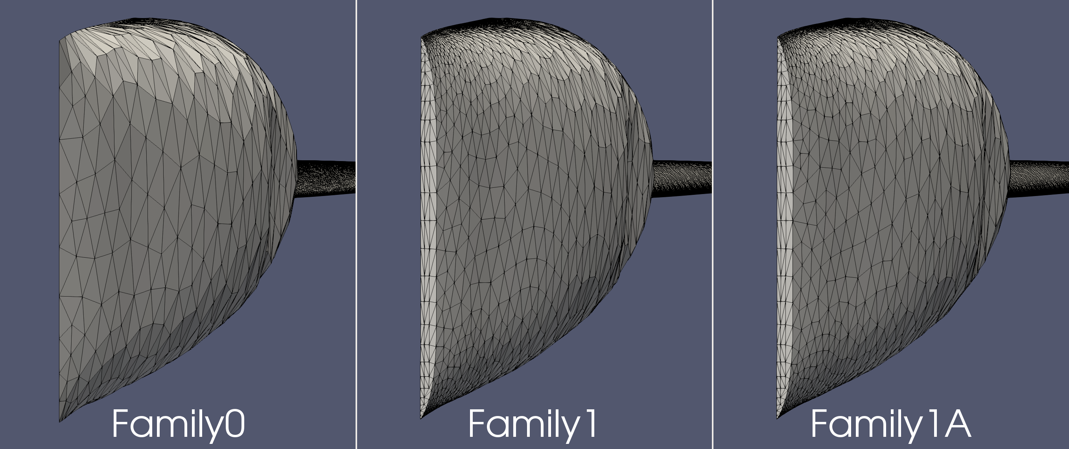
Fuselage Trailing Edge (Family0 vs Family1(A))

Slide 6
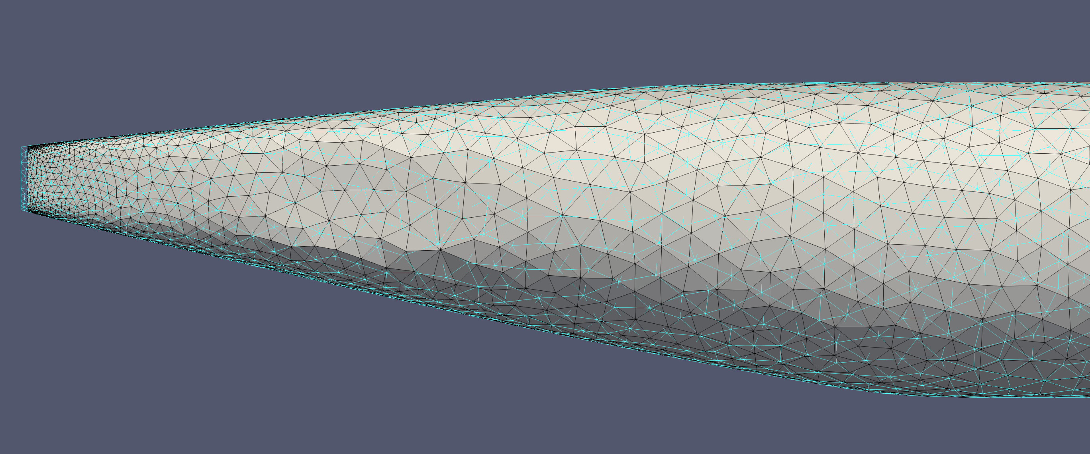
Fuselage Trailing Edge (Family0 vs Family1(A))

Slide 7
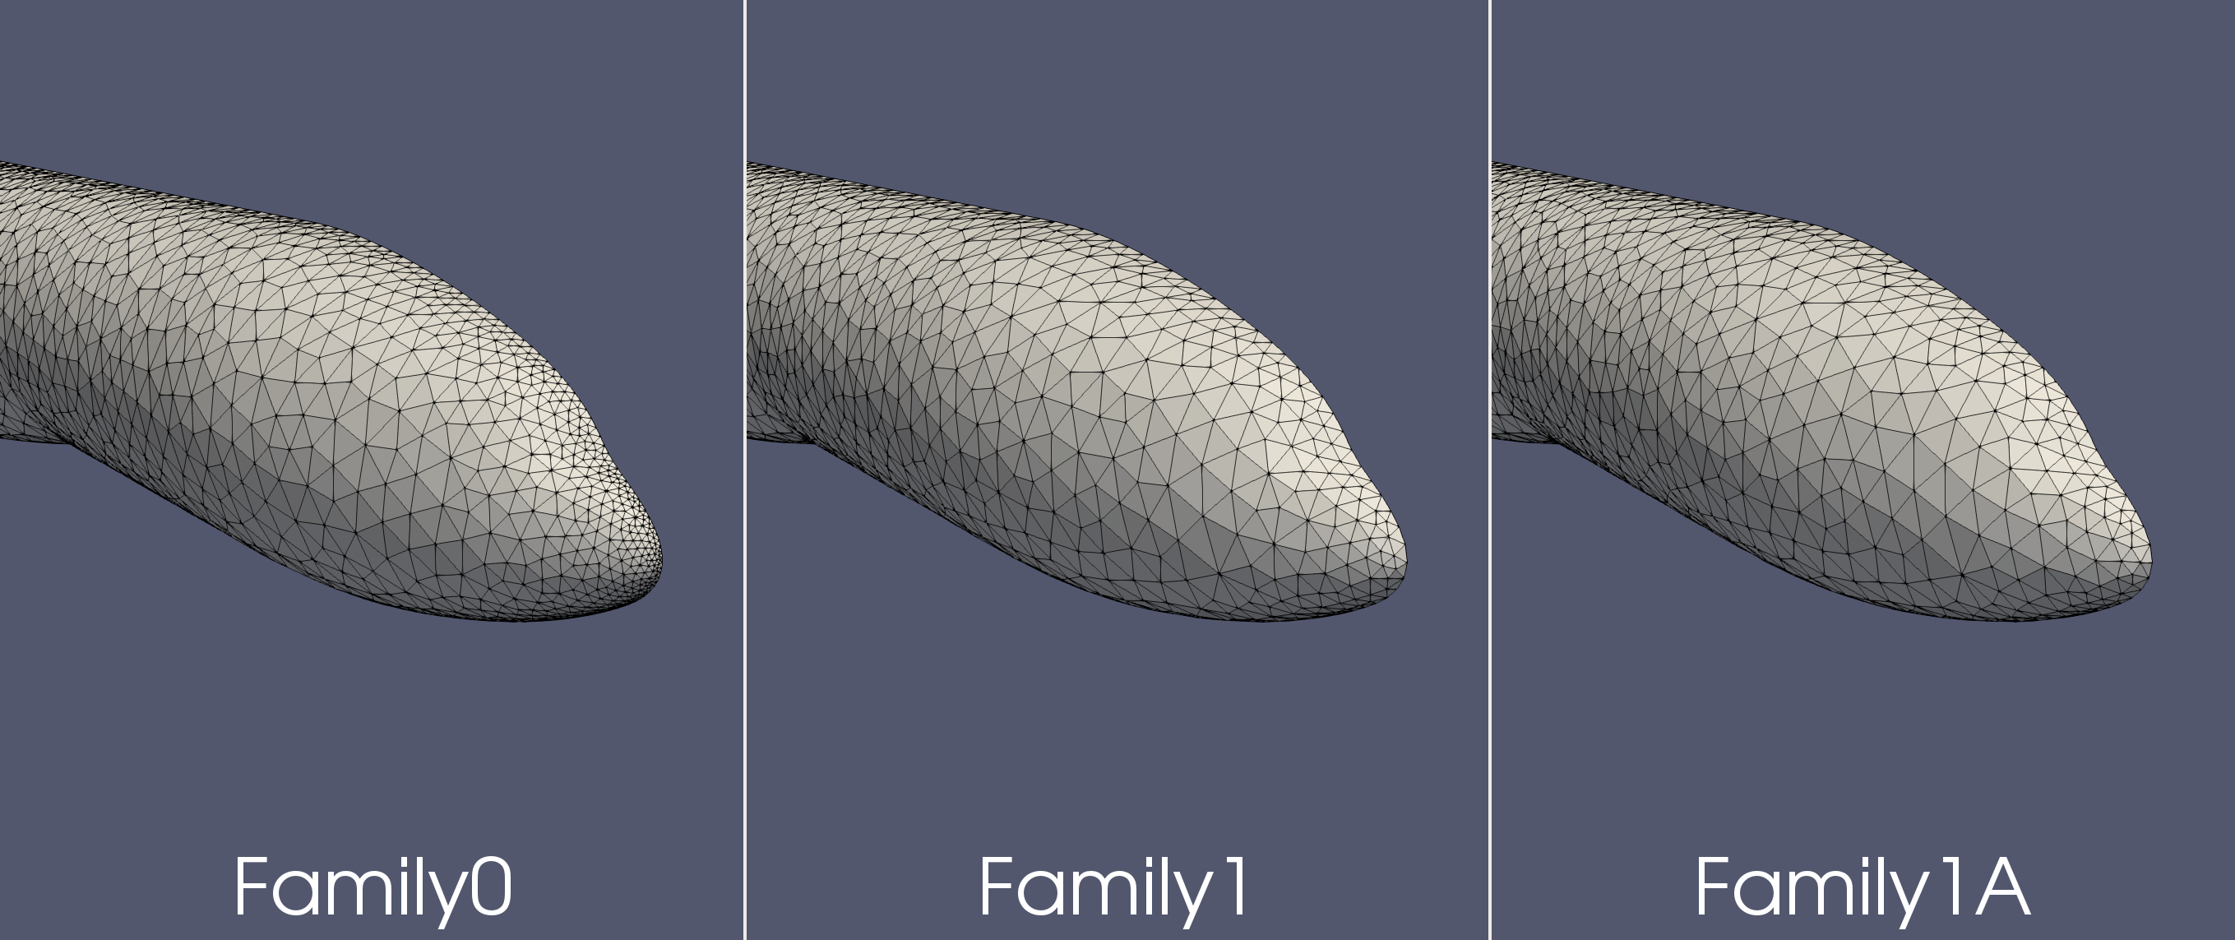
Fuselage Nose (Family0 vs Family1(A))

Slide 8
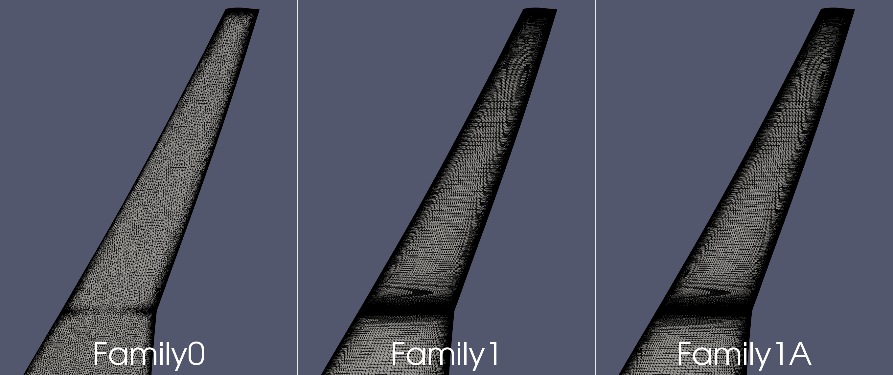
Wing (Family0 vs Family1(A))

Slide 9
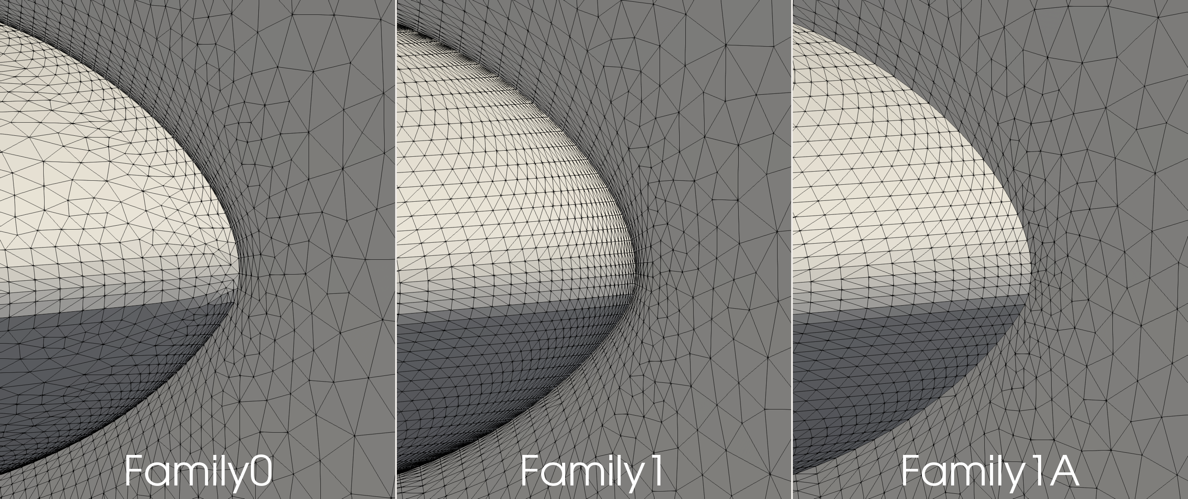
Wing Root LE (Family0 vs Family1(A))

Slide 10
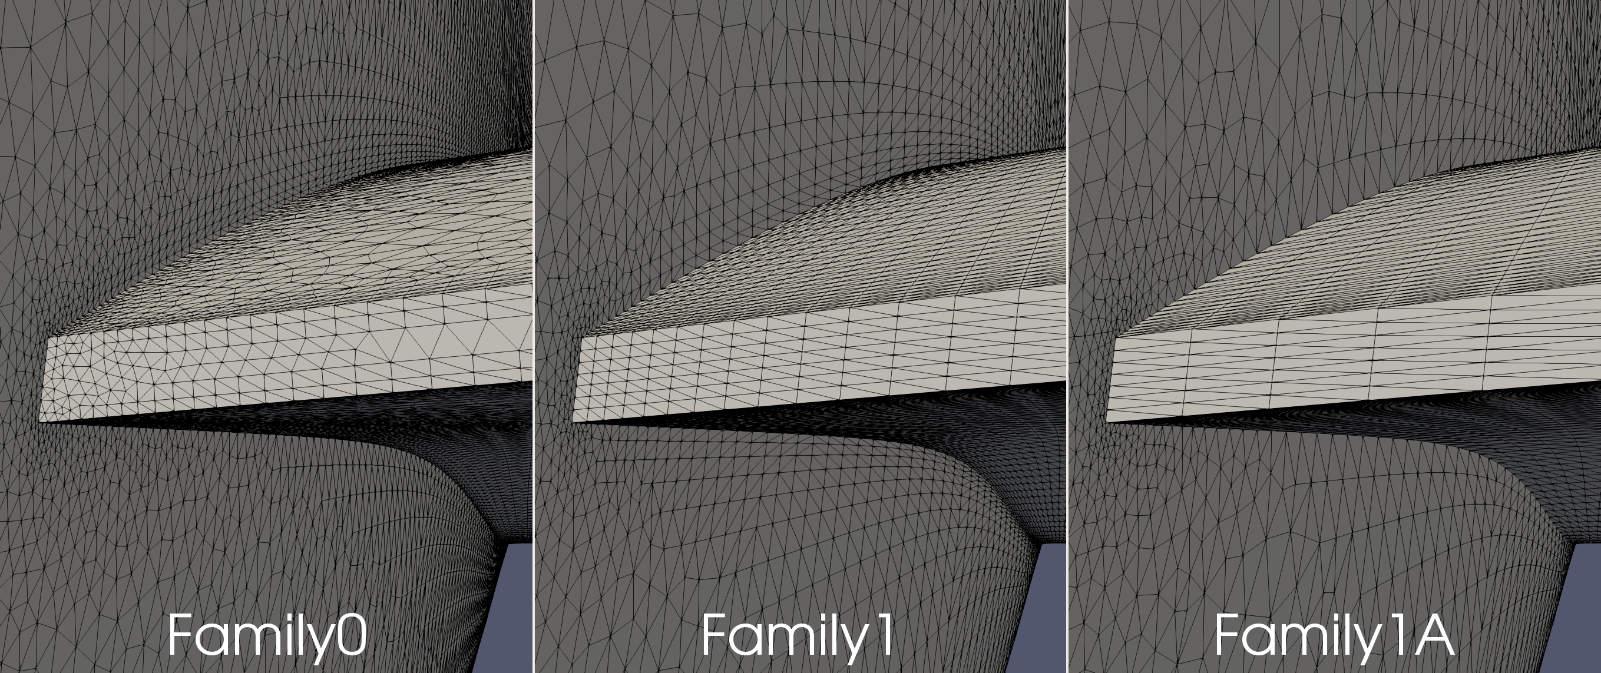
Wing Root TE (Family1 vs Family1A)

Slide 11
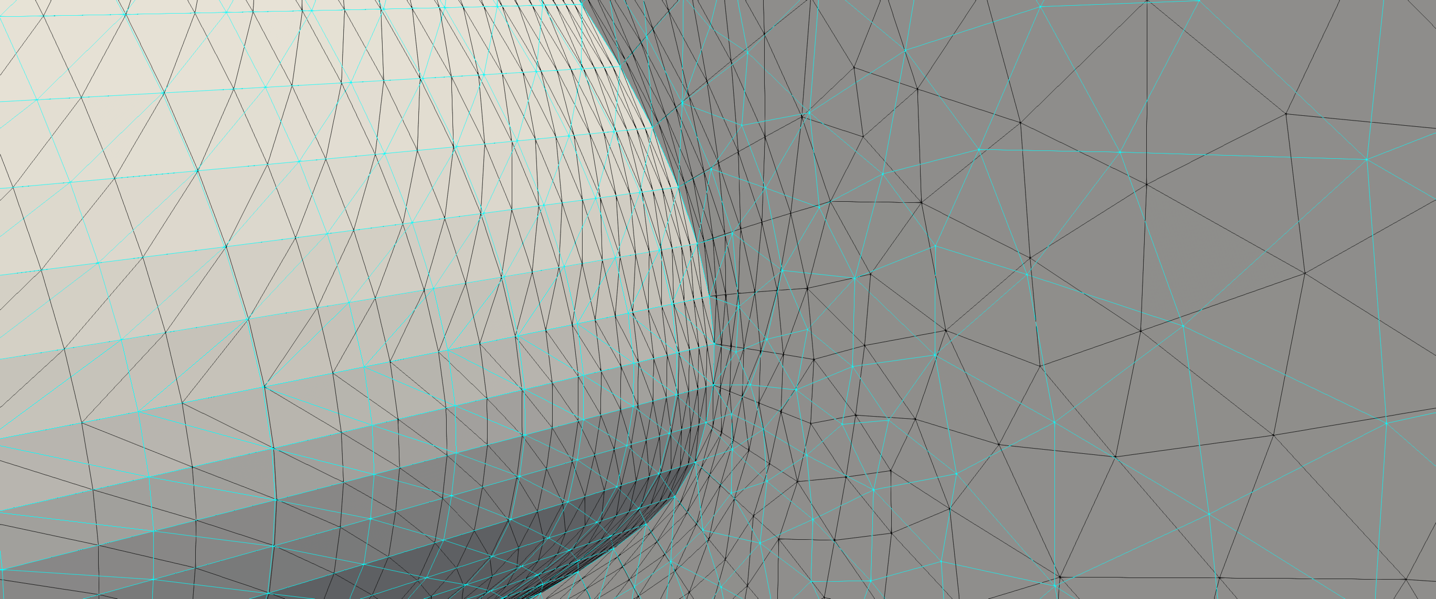
Wing Root LE (Family1 vs Family1A)

Slide 12
Recommendations
Plan to provide all three families
Suggest using Family1 or Family1A
Participants planning on using higher-order meshes should stick with Family1A
Be sure to document which family and refinement levels you are using

